Slide 1
Pneumonia Prediction
S.Dheenadhayalan
V.Keerthana Sree
S.Lokeas
A.Mogan Raj

Slide 2
Problem Statement
Pneumonia prediction using X-ray images whether the person is affected from pneumonia or not

Slide 3
Algorithm used
We have used the CNN Classification algorithm to predict the pneumonia affected people from the x-ray images
Reason for choosing the algorithm-
CNN Classifier algorithm mainly extracts more features from the image datasets rather than other classifier algorithms.

Slide 4
CNN Classification
It stands for Convolutional Neural Network(CNN)
It is a class of Deep Learning Neural Networks
CNNs use relatively little pre-processing techniques compared to other image classification algorithms

Slide 5
Design of CNN
Network Consists of
Convolutional layer
Pooling layer
Output layer

Slide 6
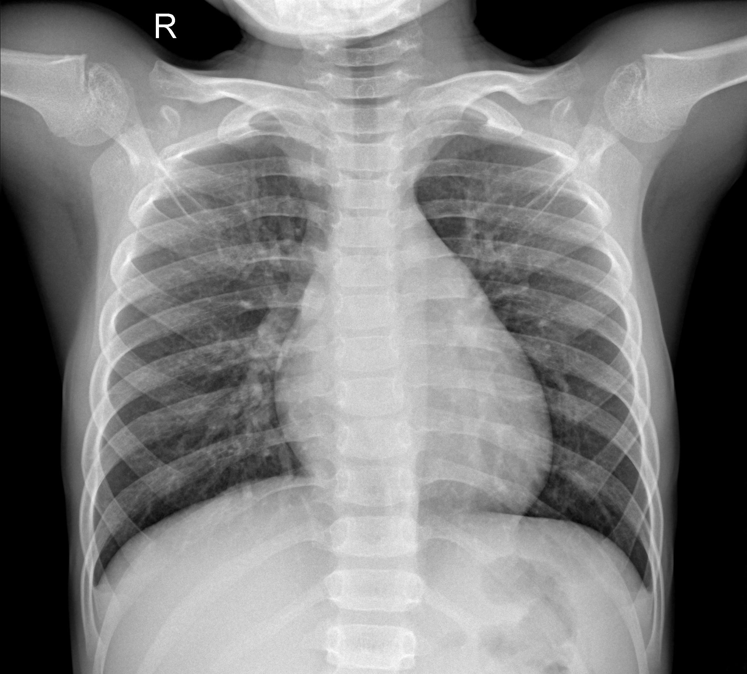
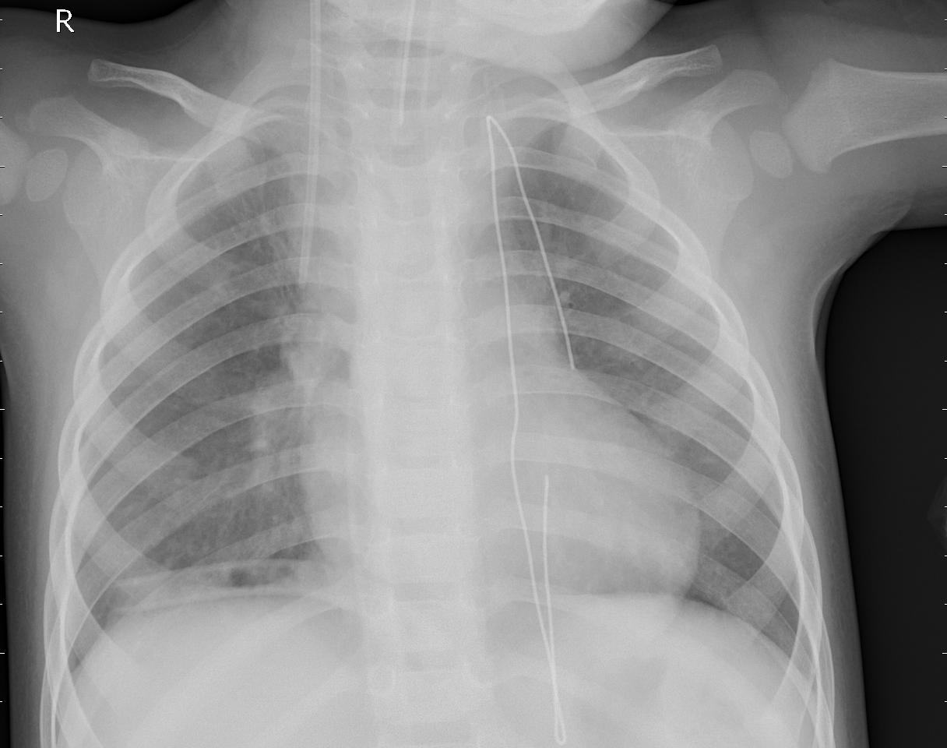
Xray images
Normal Person X-ray Pneumonia affected person
X-ray

Slide 7
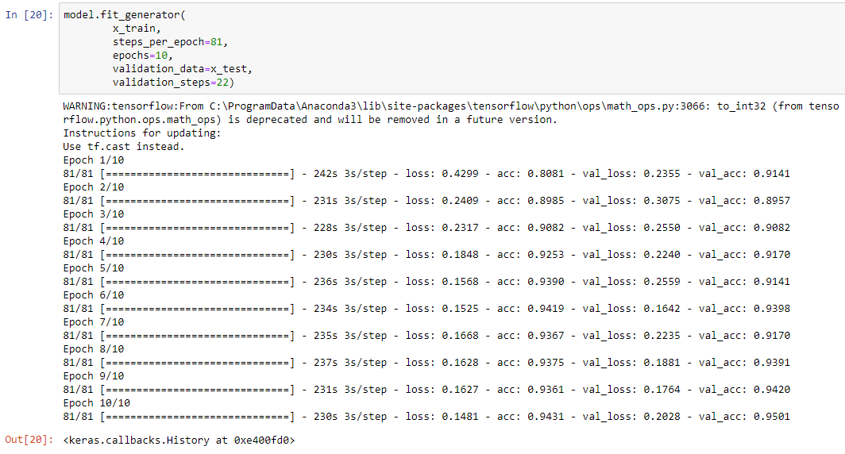
Accuracy of our model

Slide 8
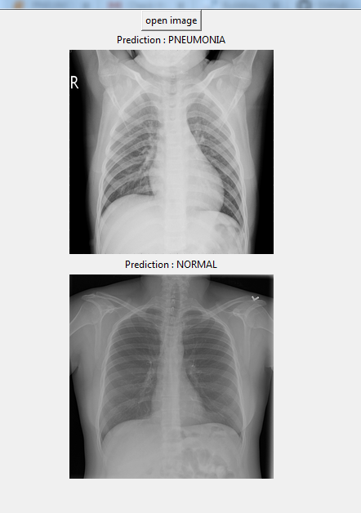
GUI

Slide 9
Thank you

